Slide 1
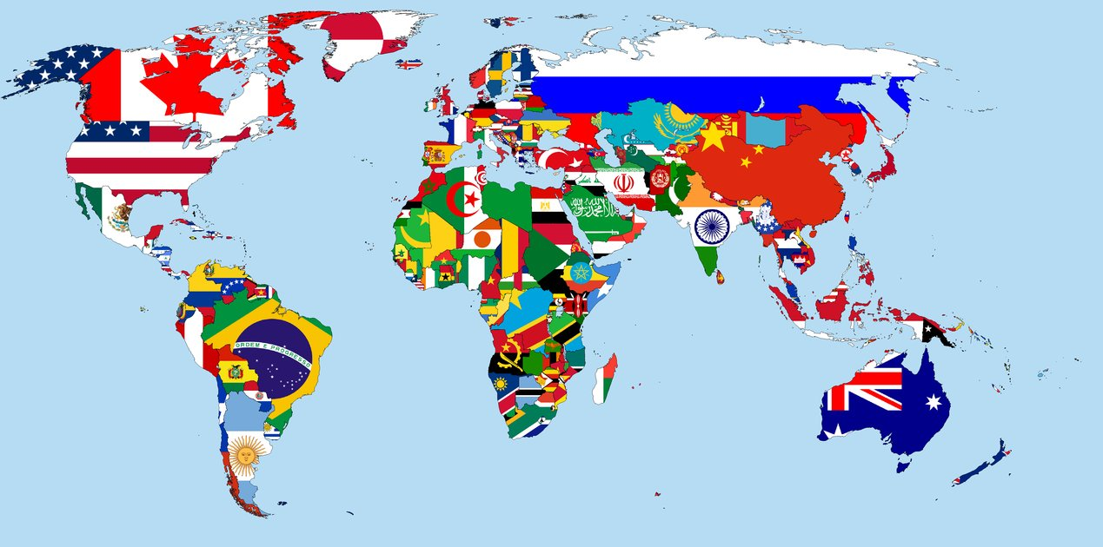
WHERE ARE YOU FROM?
E.T. RODER HUINCHO ROJAS

Slide 2

UNITED STATES AMERICAN

Slide 3

PERU PERUVIAN

Slide 4

BRAZIL BRAZILIAN

Slide 5

ARGENTINA ARGENTINIAN

Slide 6

COLOMBIA COLOMBIAN

Slide 7

CHILE CHILEAN

Slide 8

MEXICO MEXICAN

Slide 9

CANADA CANADIAN

Slide 10

FRANCE FRENCH

Slide 11

SPAIN SPANISH

Slide 12

GERMANY GERMAN

Slide 13

AUSTRALIA AUSTRALIAN

Slide 14

KOREA KOREAN

Slide 15

CHINA CHINESE

Slide 16

JAPAN JAPANESE

Slide 17





UNITED STATES
PERU
BRAZIL
ARGENTINA
SPAIN
GERMANY
JAPAN
CHINA
COLOMBIAN
CHILEAN
MEXICO
CANADA
FRANCE
AUSTRALIAN
KOREA

Slide 19
EXAMPLES
P

Slide 20
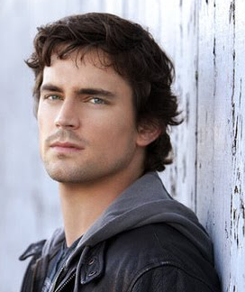

HI MY NAME IS MATTEW. I AM FROM USA, SO I AM AN AMERICAN.

Slide 21
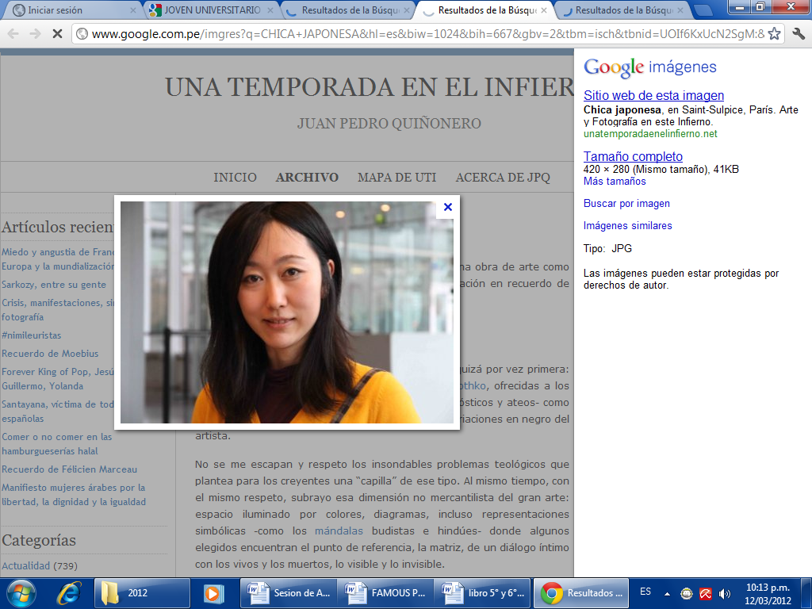
GOOD MORNING , MY NAME IS AKITA. I AM FROM JAPAN, SO I AM JAPANESE.

Slide 22
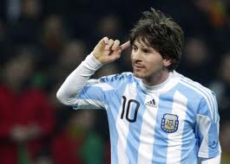
HELLO , MY NAME IS LEONEL. I AM FROM ARGENTINA, SO I AM AN ARGENTINIAN.

Slide 23
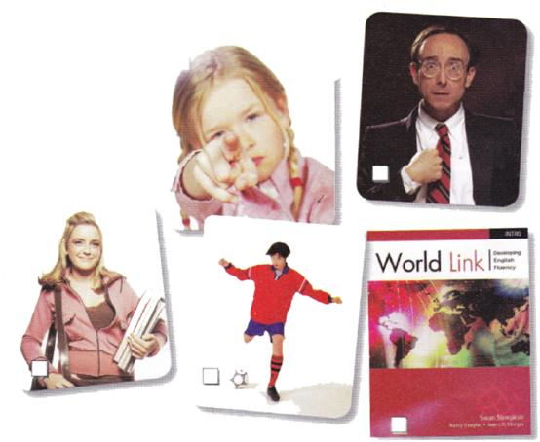
SO, WHERE ARE YOU FROM?

